Slide 1
Data Visualization of Reviews
The Slide gives the insight of the wordlcoud image

Slide 2
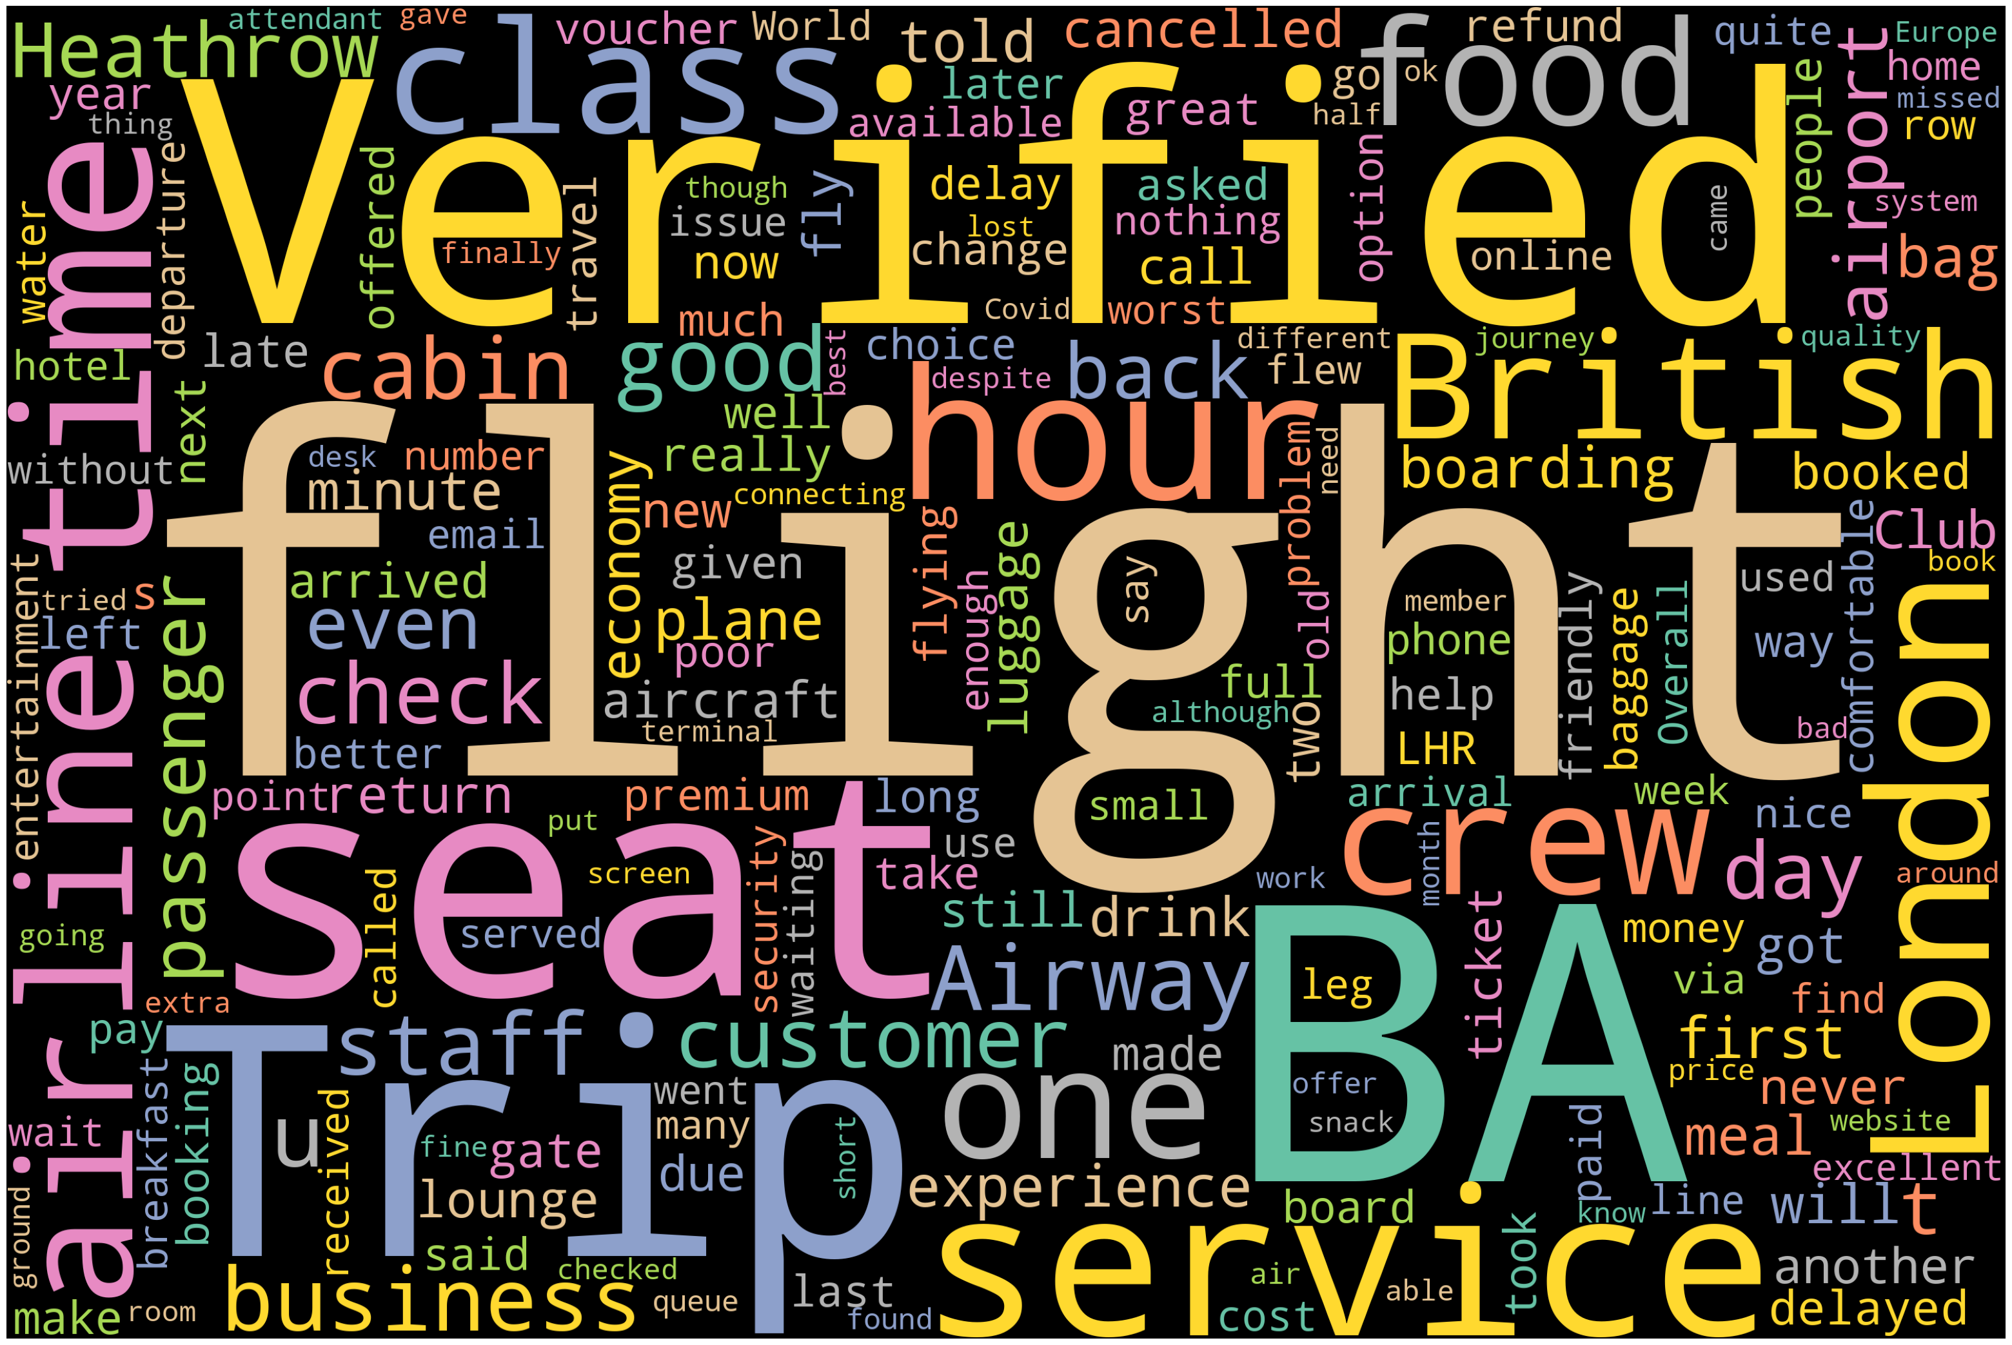
WORDCLOUD VISUALIZATION

